Slide 1
Information Visualization
Lab 1 – R Introduction

Slide 2

R as a Programming Language
Open source language for statistical computing and graphics.
Data summary and exploration, graphical presentation and data modelling .

Slide 3
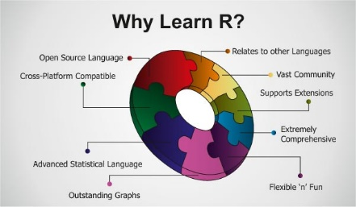
Why R?

Slide 4
Get R to Work
Download R
https://cran.r-project.org/bin/windows/base/
Download RStudio Desktop IDE – Free edition
https://www.rstudio.com/products/rstudio/download/

Slide 5
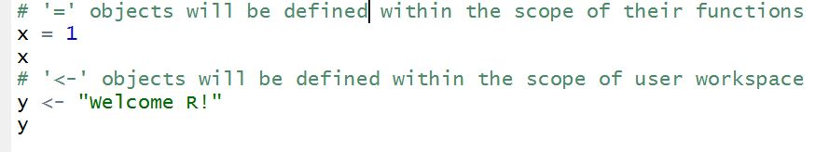
R Quick Start
Variable assignment
Assignment could be done by “=“ or “ <- “ operators, but most R developers prefer “<-”

Slide 6
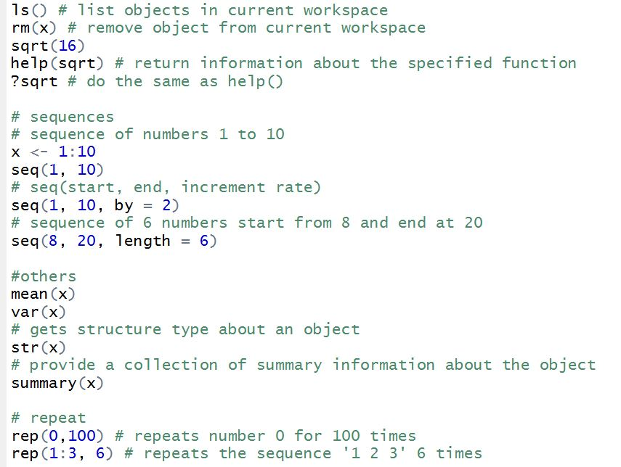
Build-in Functions (sample)

Slide 7
Exercise 1.1
1. Define x <- c(4,2,6) y <- c(1,0,-1)
Decide what the result will be of the following: (a) length(x) (b) sum(x) (c) sum(x^2) (d) x+y (e) x*y (f) x-2 (g) x^2
Use R to check your answers.

Slide 8
Exercise 1.1
2. Decide what the following sequences are and use R to check your answers:
(a) seq(4,10,by=2) (b) seq(3,30,length=10) (c) seq(6,-4,by=-2)

Slide 9
Exercise 1.1
3. Determine what the result will be of the following R expressions (a) rep(2,4) (b) rep(c(1,2),4) (c) rep(1:4,rep(3,4))
4. Use the rep function to define simply the following vectors in R. (a) 6,6,6,6,6,6 (b) 5,8,5,8,5,8,5,8 (c) 5,5,5,5,8,8,8,8

